Slide 1
Nerf Turret Project

Slide 2
Produced Solo By
Joshua Black
Mechanical Engineering Senior

Slide 3
Project Outline
Goals
Constraints
Mechanical Design
Electrical Design
Software Design
Results
0

Slide 4
Goals
1
Pan-Tilt turret connectable to household network technologies such as Wi-Fi.
Remotely controllable from any laptop.
Propel Nerf darts.
Could be used to defer porch thieves.

Slide 5
Constraits
2
Must connect to WPA2 encrypted network. (Smart phone hot spot)
Main structure must be 3-D printable.
Use pressurized gas. (Potential for pepper spray)
5V power supply.
Must be controlled through network clients.

Slide 6
THIS IS A SLIDE TITLE
Here you have:
A list of items
And some text
But remember not to overload your slides with content
Your audience will listen to you or read the content, but won’t do both.

Slide 7
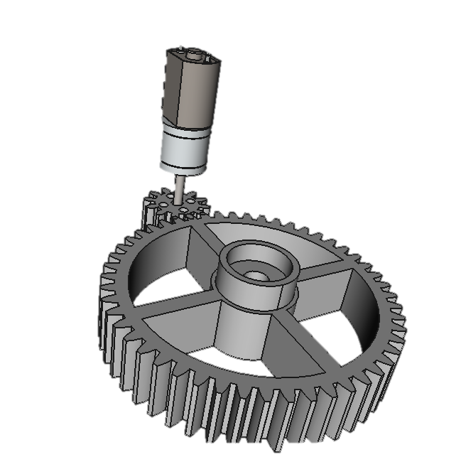
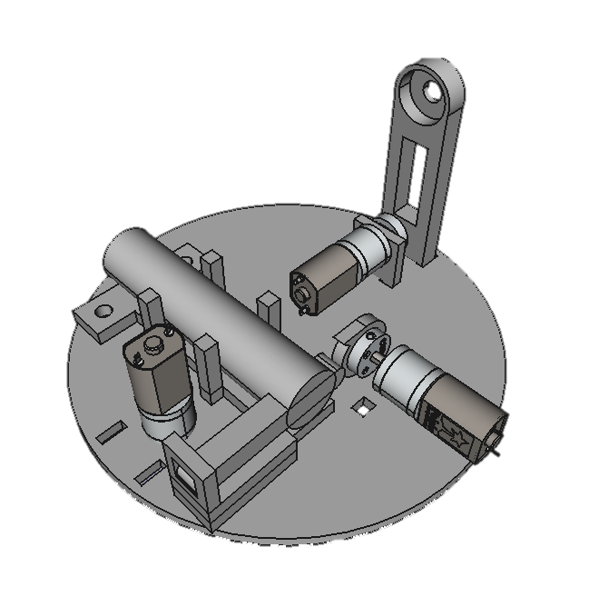
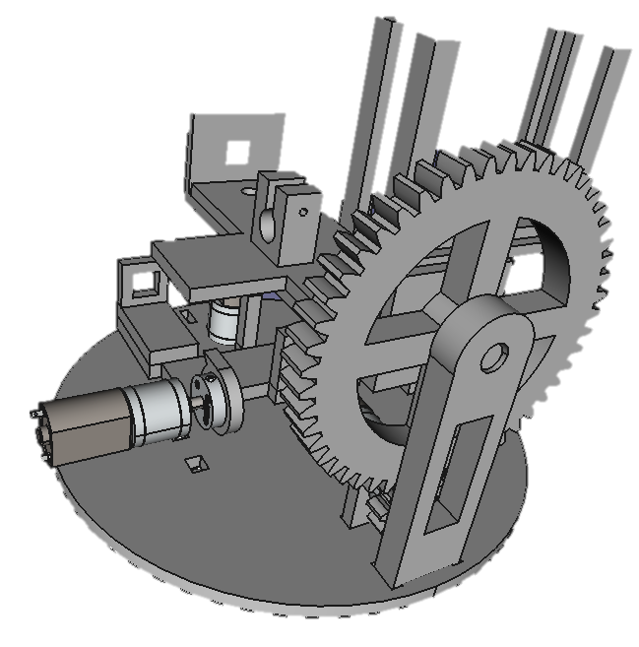
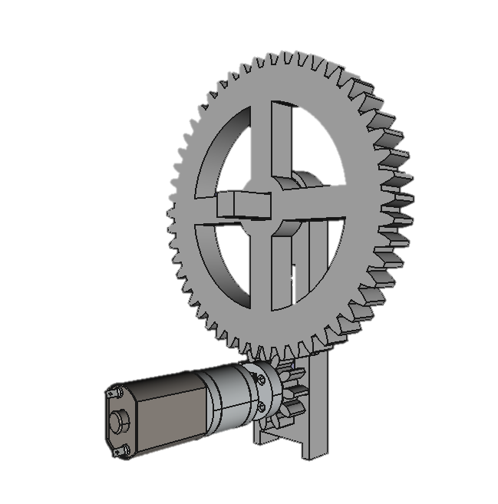
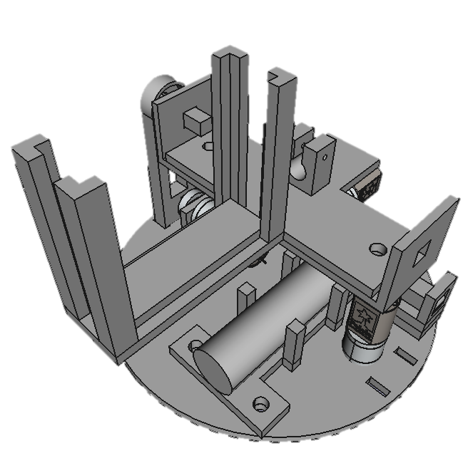
Mechanical Design
Pan Gears
Spur
5:1 ratio
Motor Driven
Base Plate
Packed
Slot and glue mounting
Rigid
Tilt Gears
Spur
5:1 ratio
Motor Driven
Nerf Payload
Pinned mount
Pressure clip holder
Nozzle clamp

Slide 8
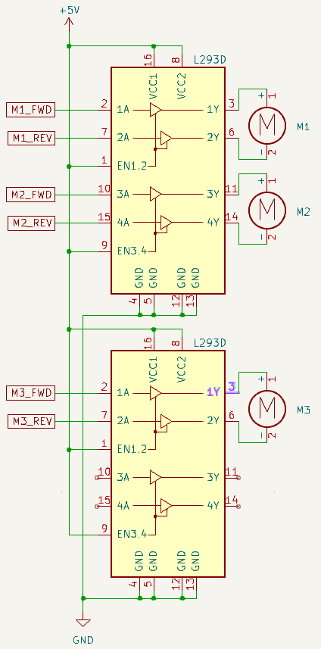
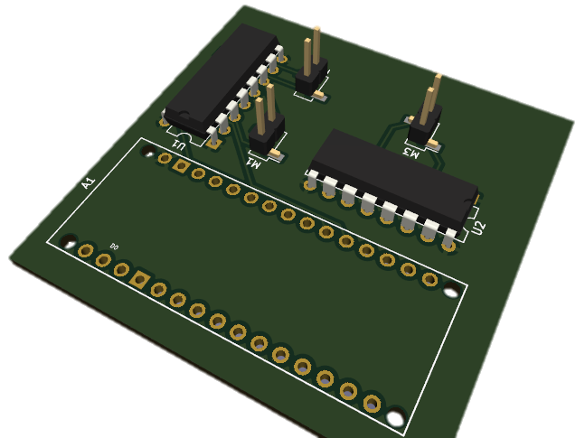
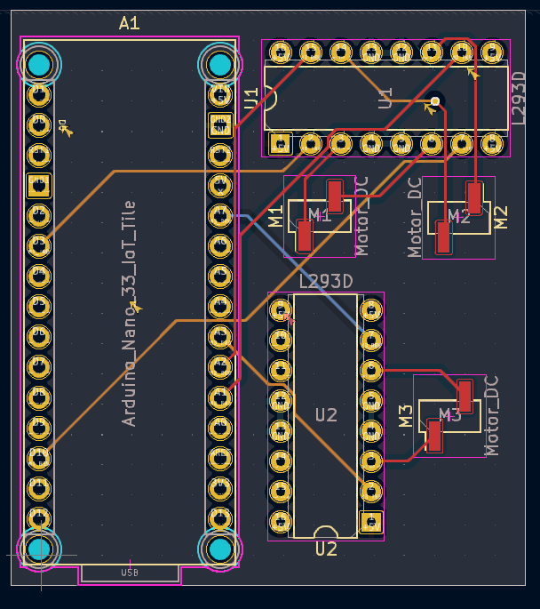
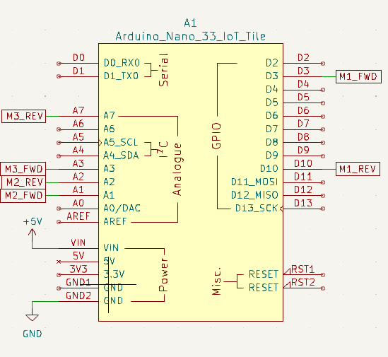
Electrical Design
PCB
4 Layers
Compact
Not implemented
Schematic
Nano 33 IOT
5V
4 possible motors

Slide 9
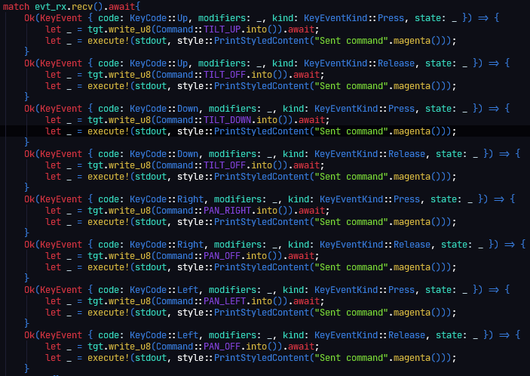

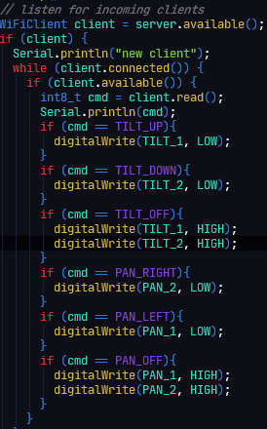

Software Design
Initialize Nina Wifi chip
Connect to SSID
Open TCP server on port 1000
Traffic Loop
Can for target SSID
Match Case
Actuate pins
Receive Packet

Slide 10
Results
Mechanical
Great base plate rigidity with super glue
Compact
Tilt motor at torque capacity
Need different CO2 firing assembly
Electrical
Simple
Can use higher voltage for more motor torque
Implementing PCB can save space
Battery maybe oversized
Software
Success with network systems
Easy network scan and connection
Arrow key interface is fun
Fault tolerant

Slide 11
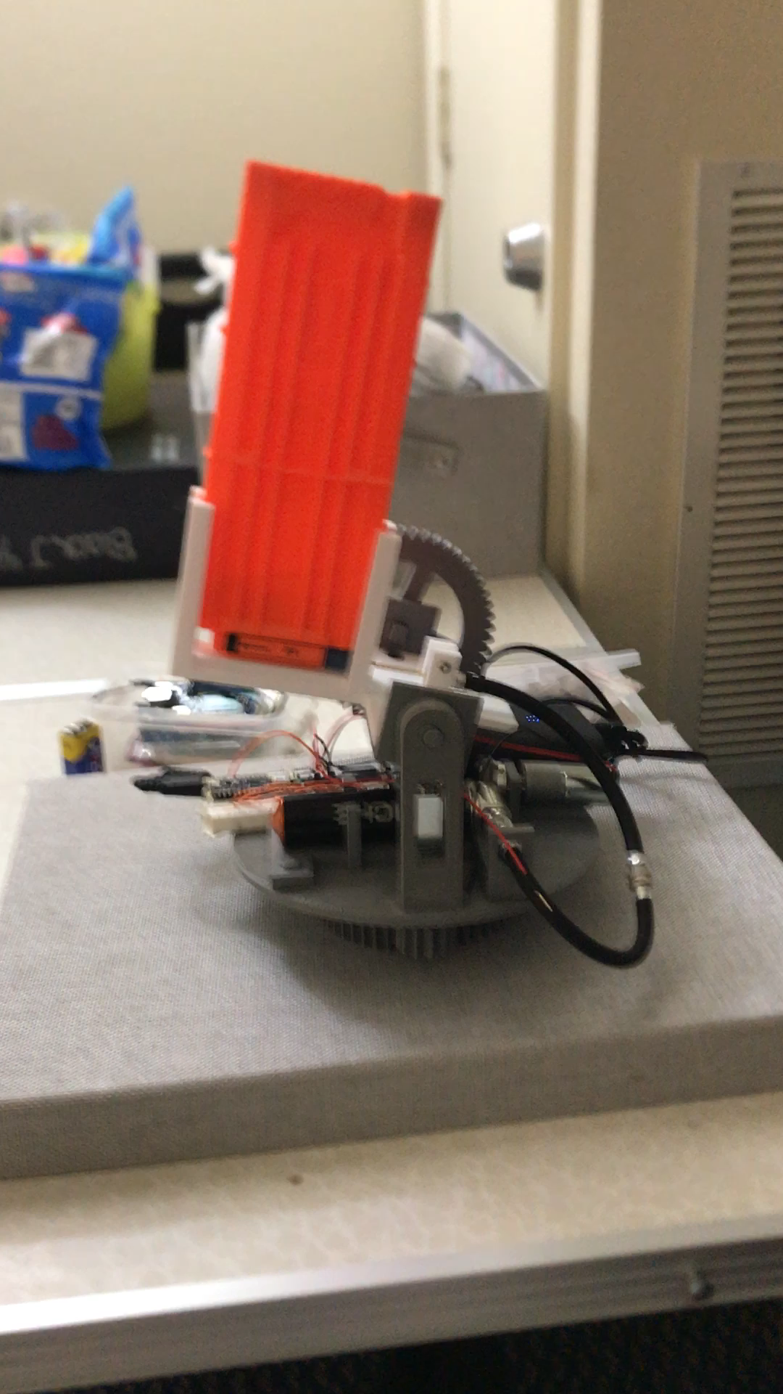
https://drive.google.com/file/d/11LYkKGSudl8TtC4clvGSsLEwLnAlpMwB/view?usp=sharing
Functional_turret.MOV

